Slide 1

Team Hafiz Mahir Saeed ….. 18F-0179 Muhammad Affan Khalid 18F-0154 Muhammad Taimor Ali khan 18F-0482
Supervisor:
Rizwan-ul-haq

Slide 2
Outline (FYP Report v 1.0)
Introduction
Use Case Diagram
Activity Diagram
Class Diagram
Sequence Diagram
System Sequence Diagram
Domain Model
High Level/Architecture/Block Diagram

Slide 3
Project Introduction
We are developing an efficient automated system to remove all paper work and to minimize the human errors.
Sensors are used for measuring the tanker and calculating the daily sales of petrol and maintaining the data of sales and employee in servers.
Fingerprint sensors are used for employee attendance, marking their working hours and also used to maintain the safety of main tank by sending a message to the admin when open or closed. Fire alarms notification are used to notify admin in order to take emergency measures

Slide 4
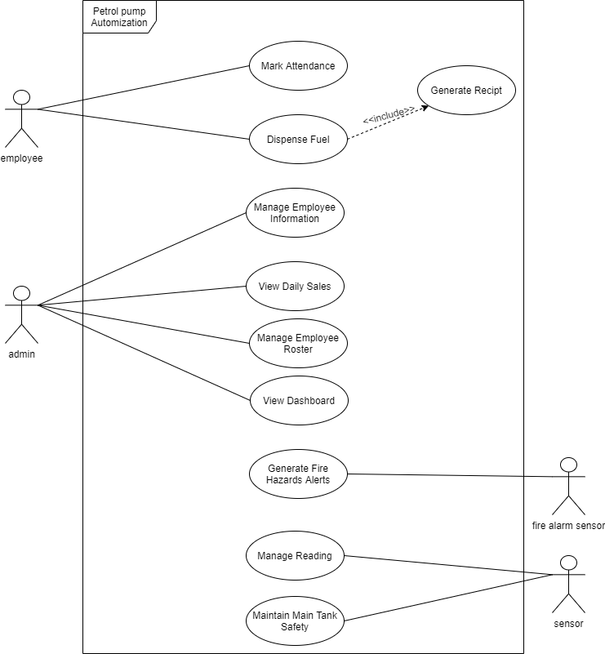
Use Case Diagram

Slide 5
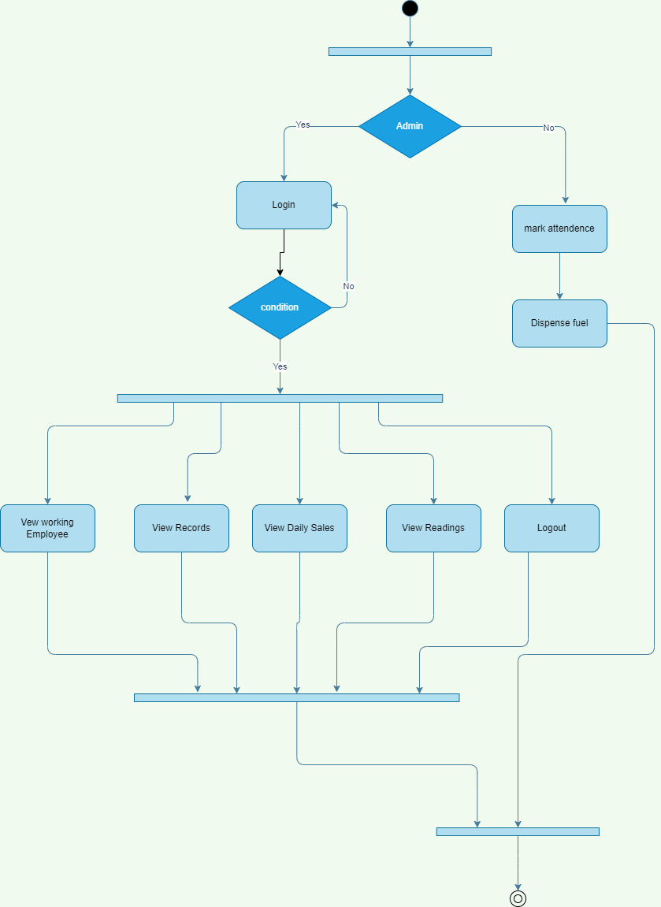
Activity Diagram

Slide 6
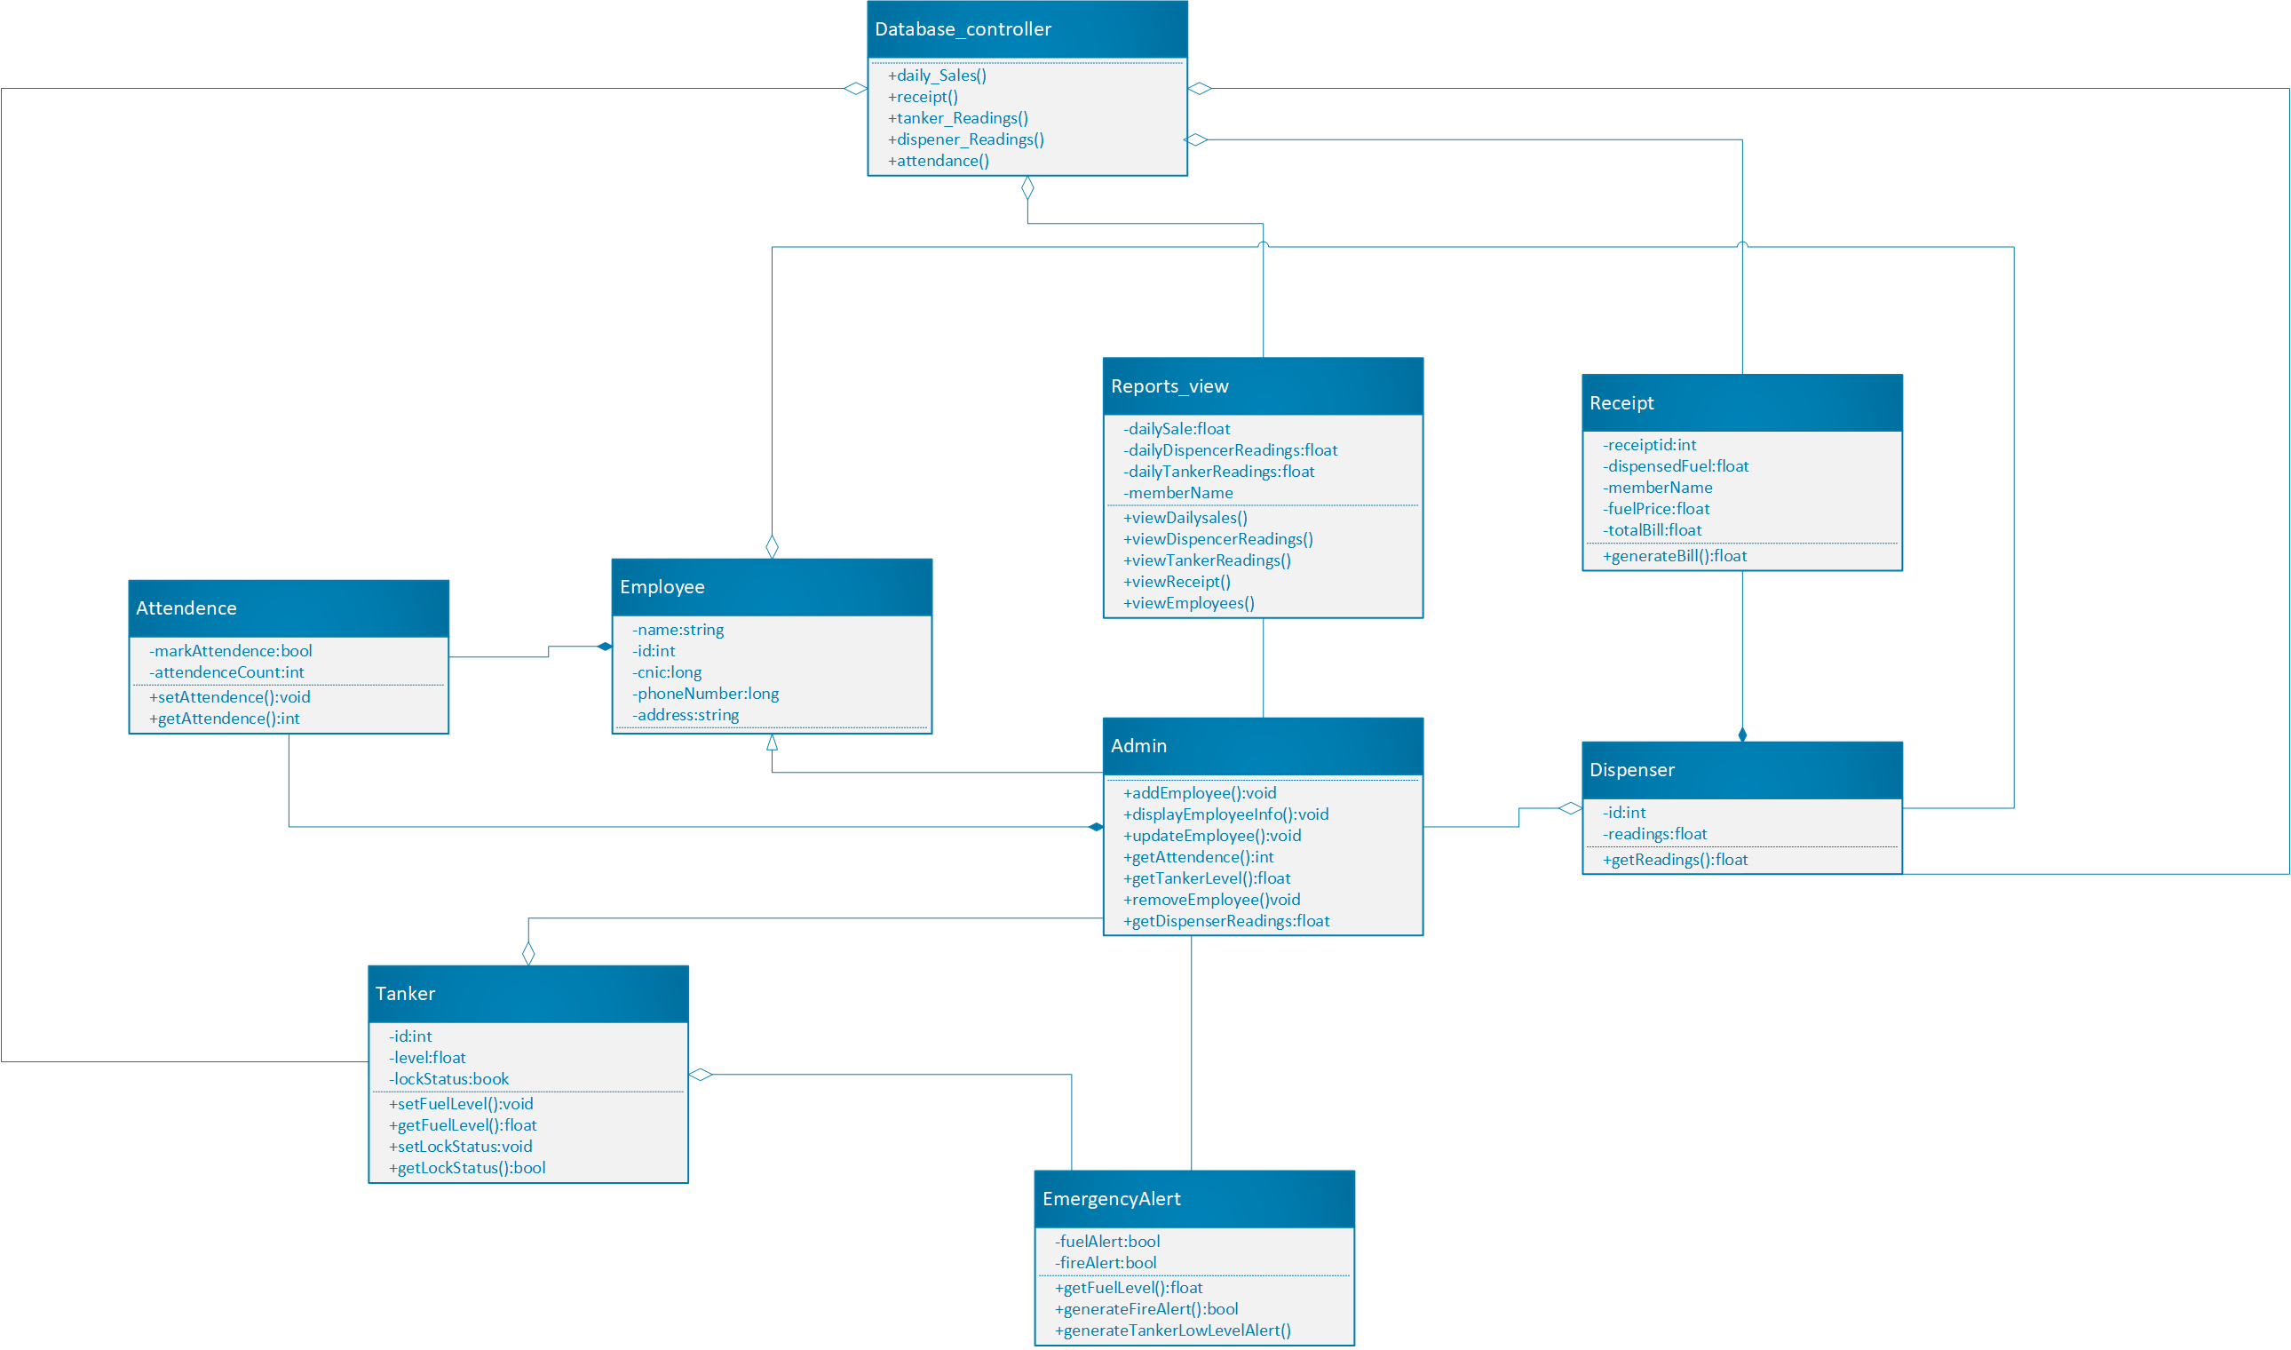
Class diagram

Slide 7
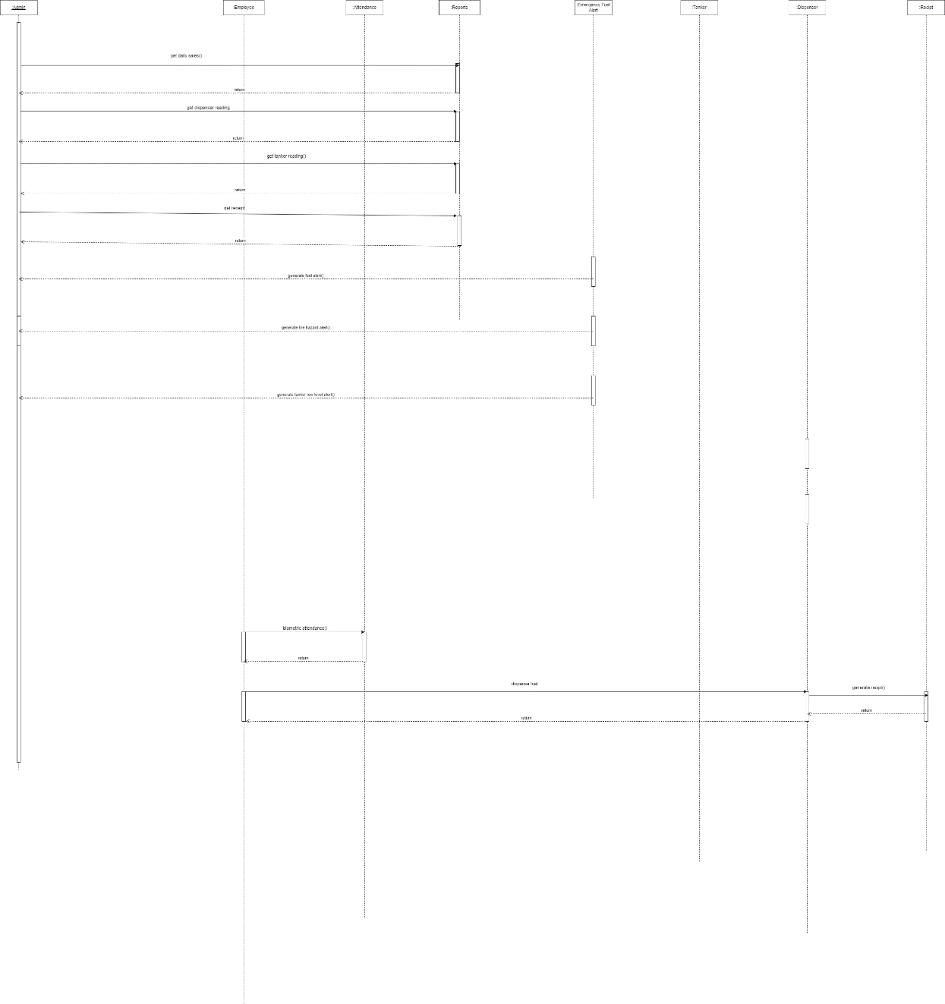
Sequence Diagram

Slide 8
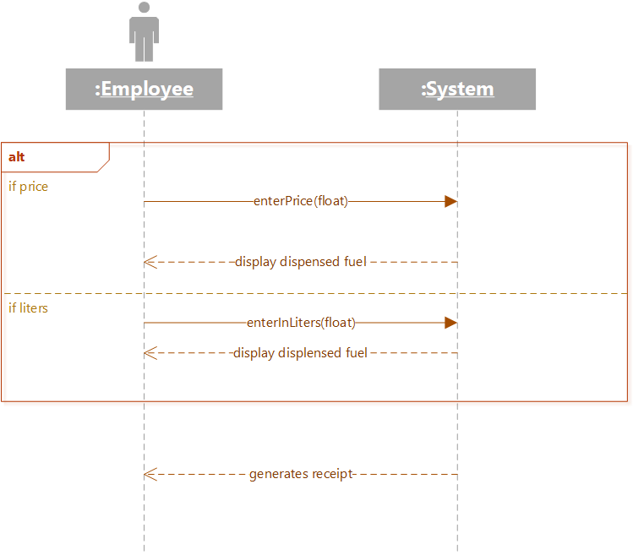
System Sequence Diagram

Slide 9
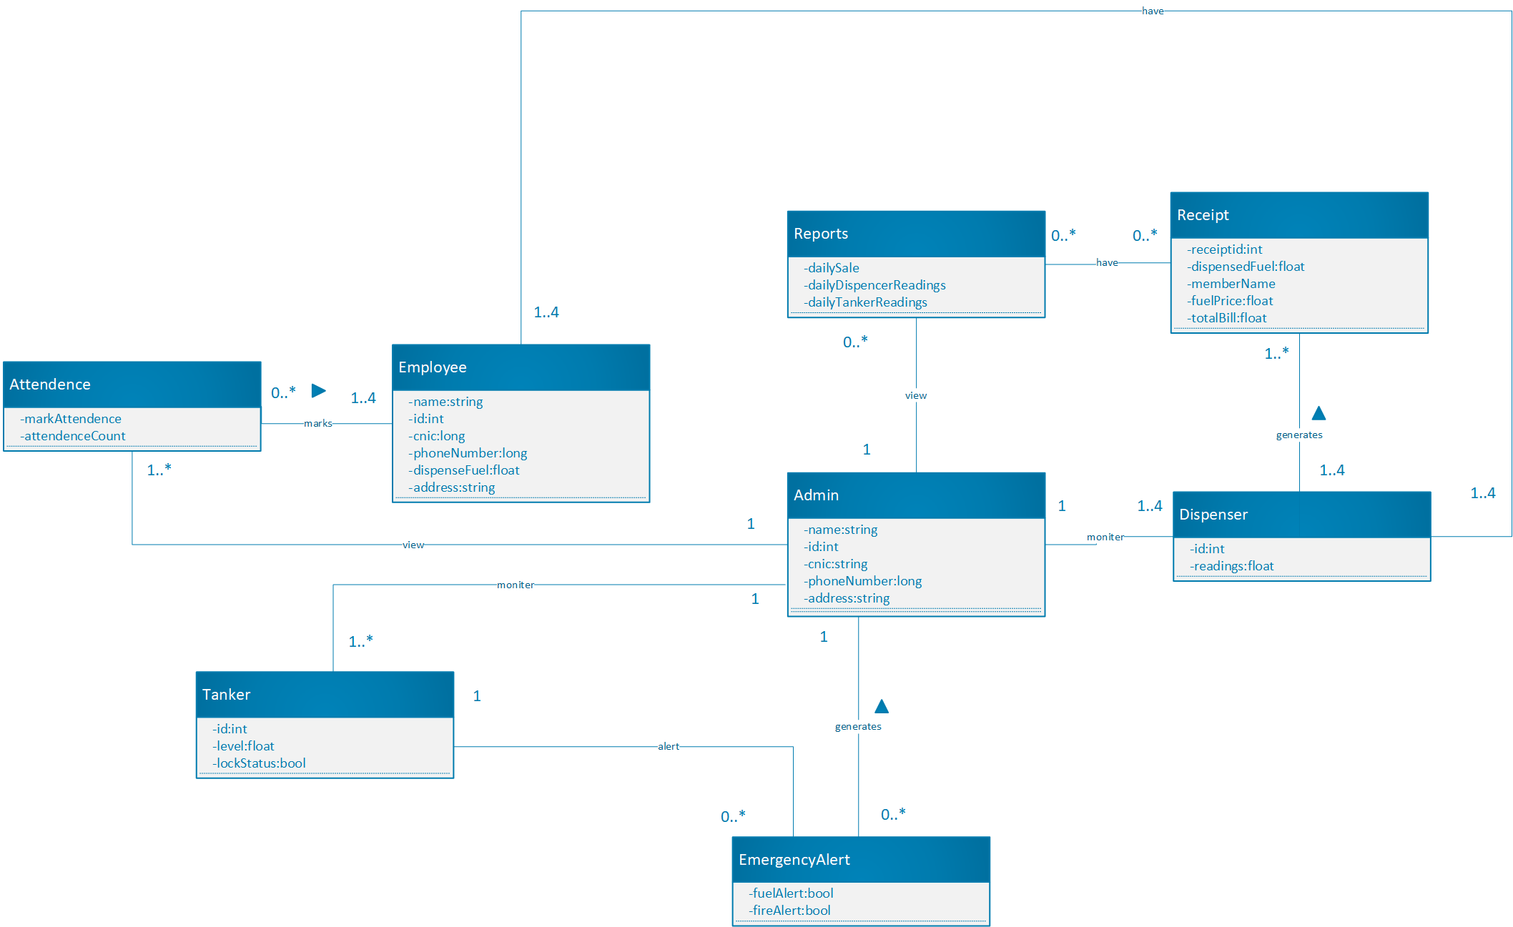
Domain Model

Slide 10
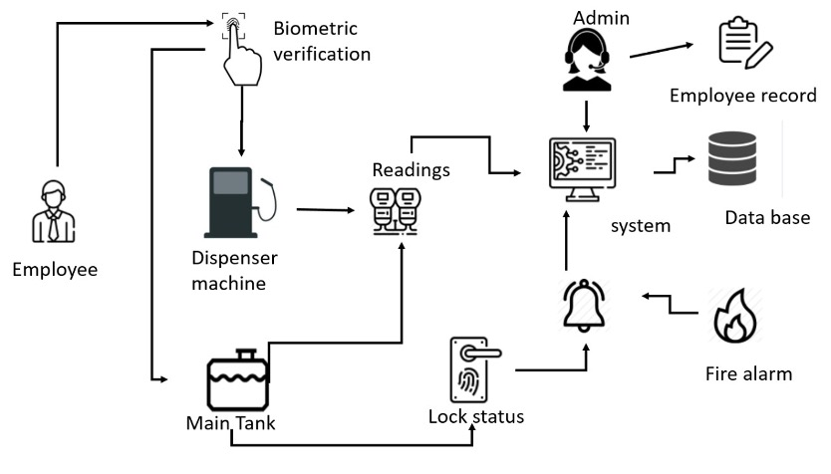
Architecture Diagram

Slide 11
Thank You

